Slide 1
Express Generator

Slide 2
Objectives
Quickly scaffold out a typical Express application using express-generator
Build an Express server to support REST API

Slide 3
Express Generator
Quick scaffolding tool to generate an Express application skeleton
Installing Express generator by typing the following at the prompt:
npm install -g express-generator
Use sudo if you are using an OSX or Linux machine.
Note: You may need to restart your terminal/cmd window in order for the express command to be available at the prompt.

Slide 4
Express Generator
Generating an Express application
express <App Name>
– Generates a folder under the current folder with the name <App Name>
– Various options available
Then, move to the folder and install the node modules:
npm install

Slide 5
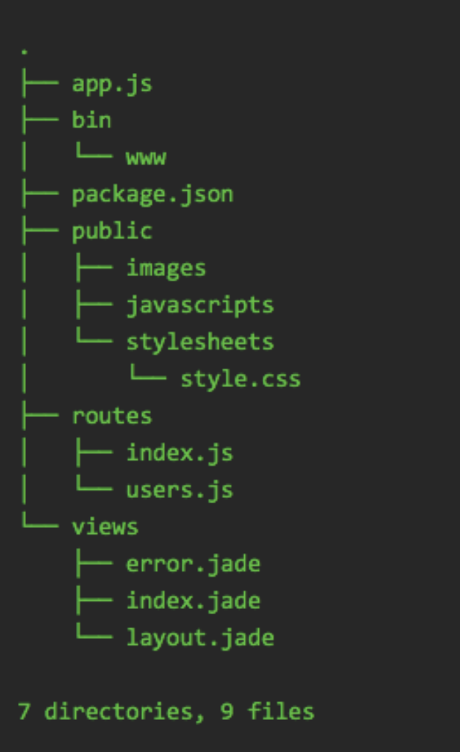
Generated Application
app.js: starting application
package.json
public: static resources
routes: application routes
views: template engine templates

Slide 6
Generating an Express application using the express-generator

Slide 7
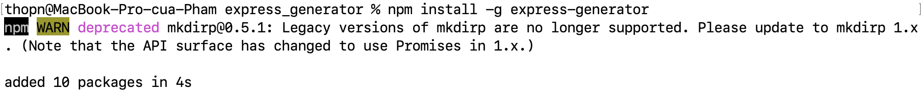
Installing express-generator
Install express-generator by typing the following at the prompt:
npm install express-generator -g

Slide 8
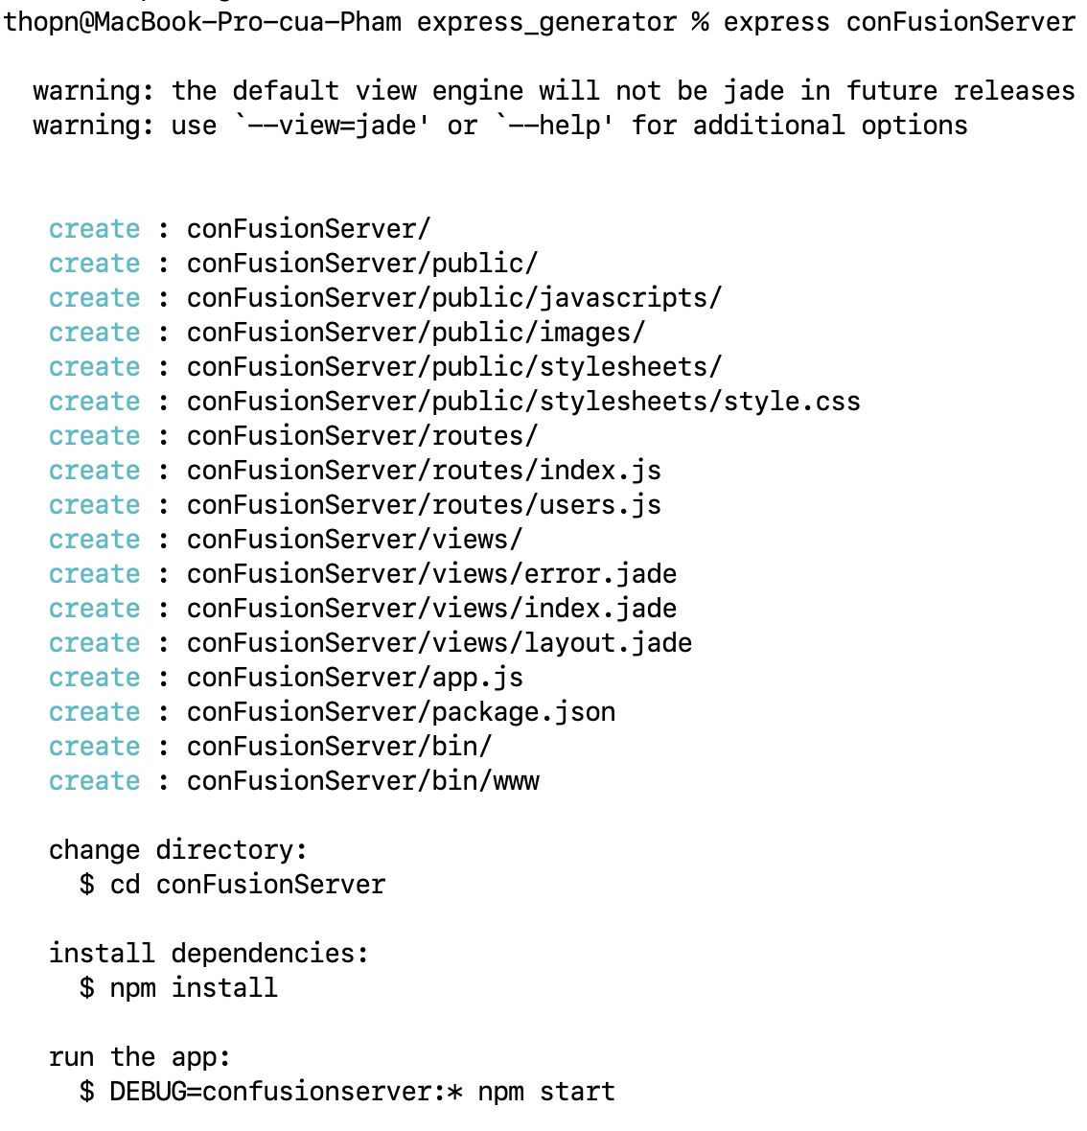
Scaffolding an Express Application
To scaffold out an Express application, type the following at the prompt:
express conFusionServer

Slide 9
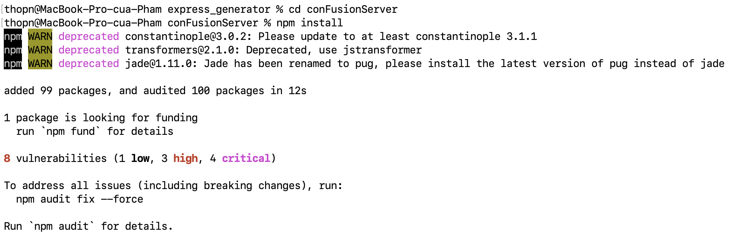
Scaffolding an Express Application
Next, move to the conFusionServer folder. Type the following at the command prompt to install all the Node modules
You can start the Express server by typing the following at the prompt:
npm install
npm start

Slide 10
Build an Express server to support REST API

Slide 11
Implementing a REST API
Now, copy the dishRouter.js, promoRouter.js and leaderRouter.js from your first assignment (node-express/routes folder) to the routes folder within the Express application that you just scaffolded out.
Furthermore, copy the index.html and aboutus.html file from the node-express/public folder to the public folder in your new project.

Slide 12
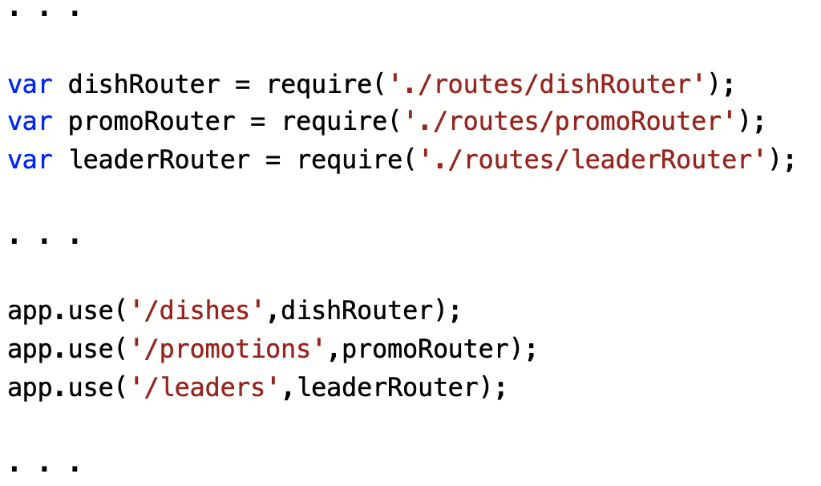
Implementing a REST API
Then, open the app.js file and then update the code in there as follows:

Slide 13
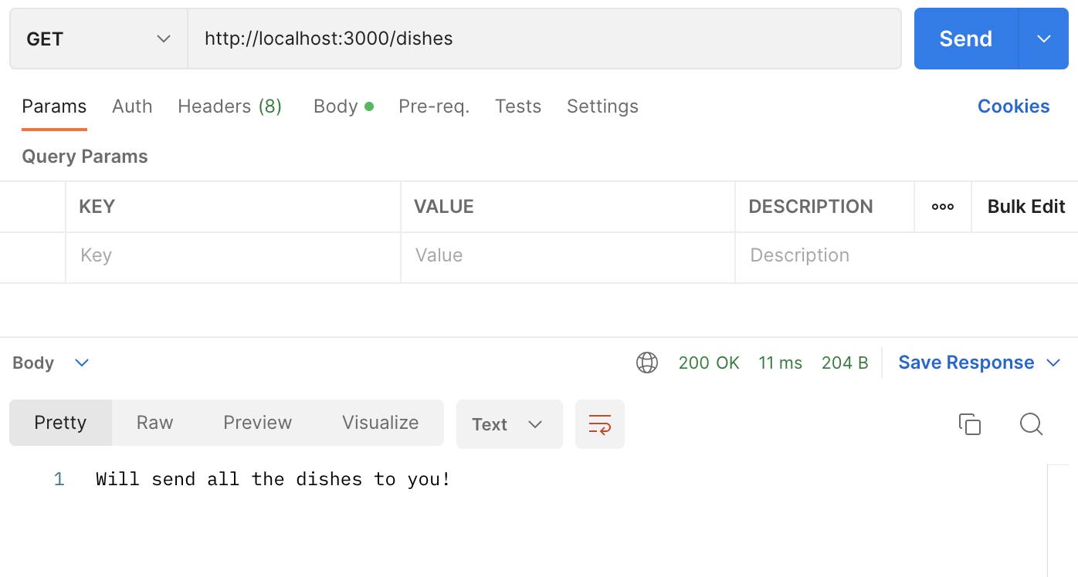
Implementing a REST API
Save the changes and run the server. You can then test the server by sending requests and observing the behavior.

Slide 14
Summary
Understand the Express Generator
Understand the quickly scaffold out a typical Express application using express-generator
Step by step build and implement an Express server to support REST API

